Slide 1
CryoEM and phase separation
The structural basis of Rubisco phase separation
in the pyrenoid

Slide 2

Martin Jonikas
Department of Molecular Biology Princeton University
Biogenesis, function, and engineering of the eukaryotic CO2-fixing organelle, the pyrenoid
Ph.D., Molecular Biology and Genetics, University of California, San Francisco
B.S., Aerospace Engineering, Massachusetts Institute of Technology

Slide 3
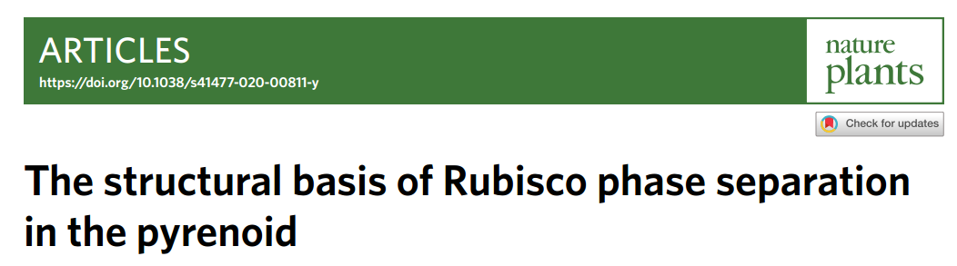
Major breakthrough
In vitro acquisition of structures of protein complexes undergoing phase separation

Slide 4
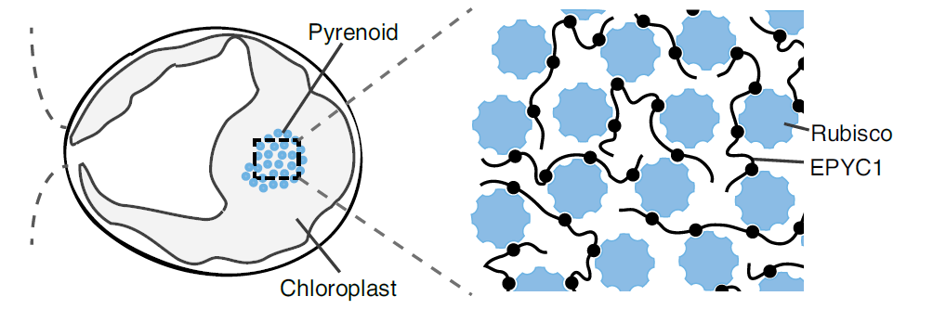
Introduction
All eukaryotic algae and some land plants

Slide 5
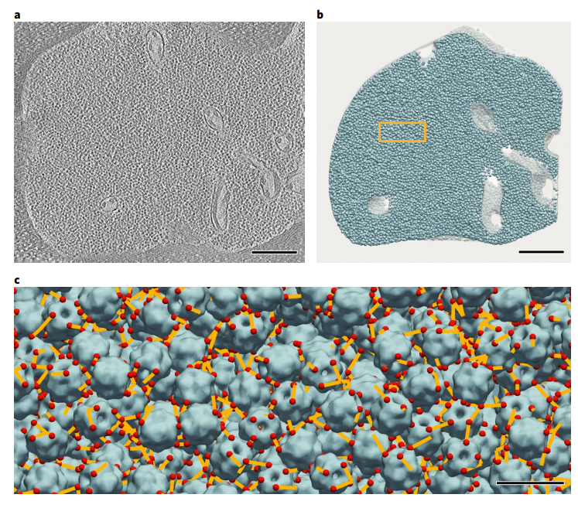
Introduction
Scale bar, 200 nm

Slide 6
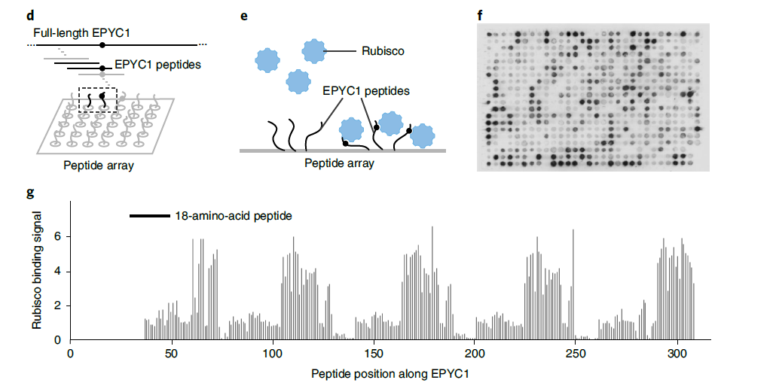
EPYC1 has five nearly identical Rubisco-binding regions
18 aa
Hypothesis: the Rubisco-binding regions of EPYC1 were short and could bind to Rubisco as peptides without a need for tertiary folds

Slide 7
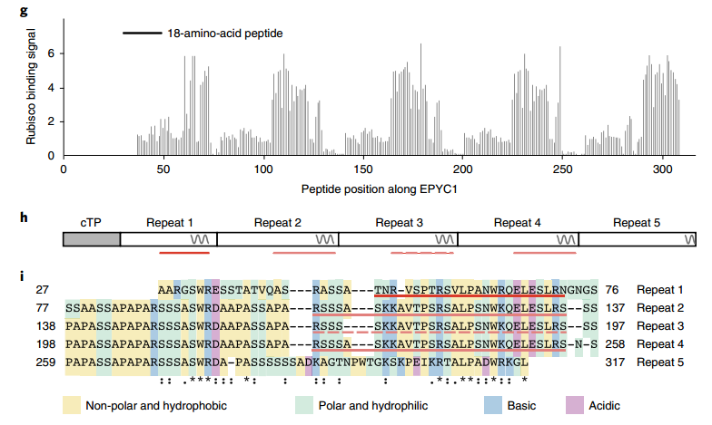
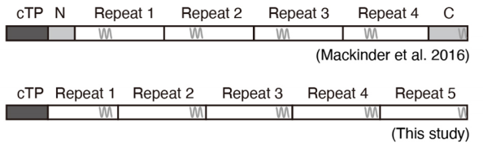
EPYC1 has five nearly identical Rubisco-binding regions

Slide 8
EPYC1 has five nearly identical Rubisco-binding regions

Slide 9
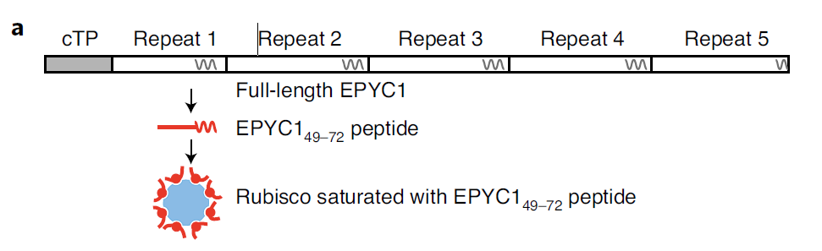
EPYC1 binds to Rubisco small subunits
EPYC1_{106–135}

Slide 10
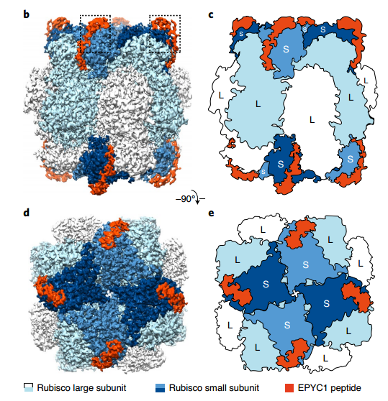
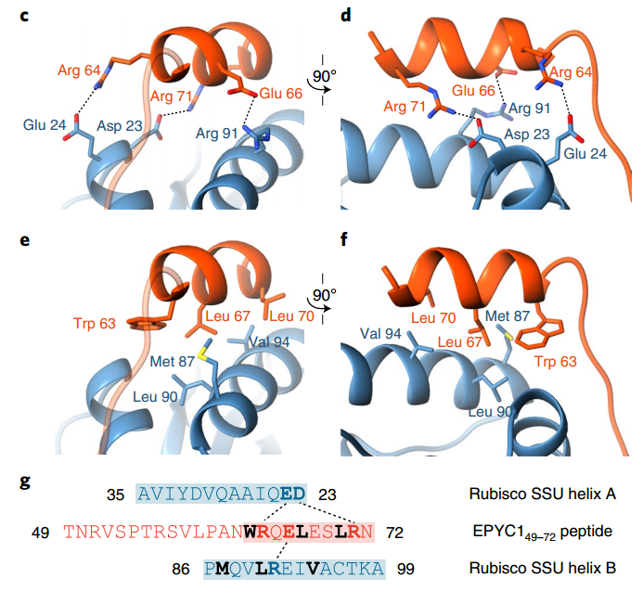
EPYC1 binds to Rubisco small subunits

Slide 11
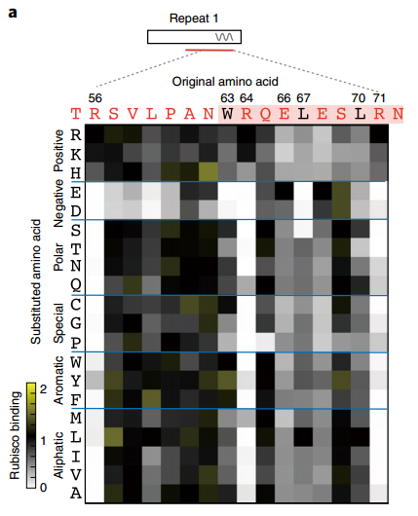
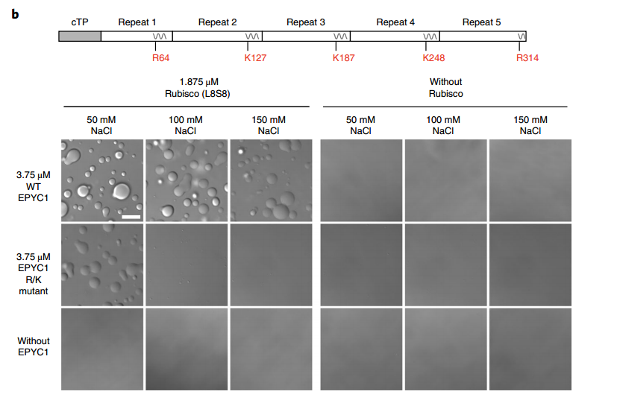
Binding and phase separation require interface residues

Slide 12
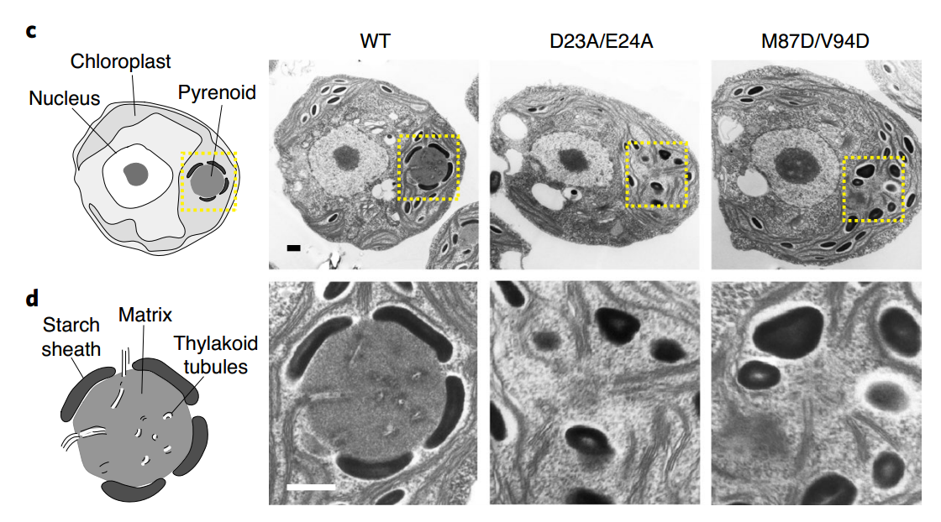
Pyrenoid matrix formation requires interface residues

Slide 13
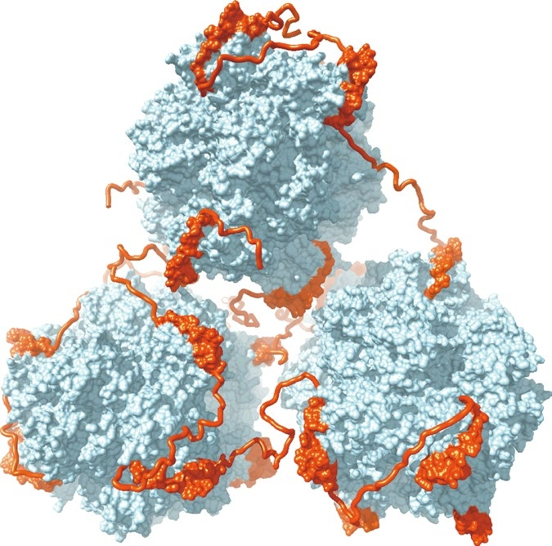
Pyrenoid matrix formation requires interface residues

Slide 14
Limitation
Dynamic nature
Low contrast
Sample homogeneity

Slide 15
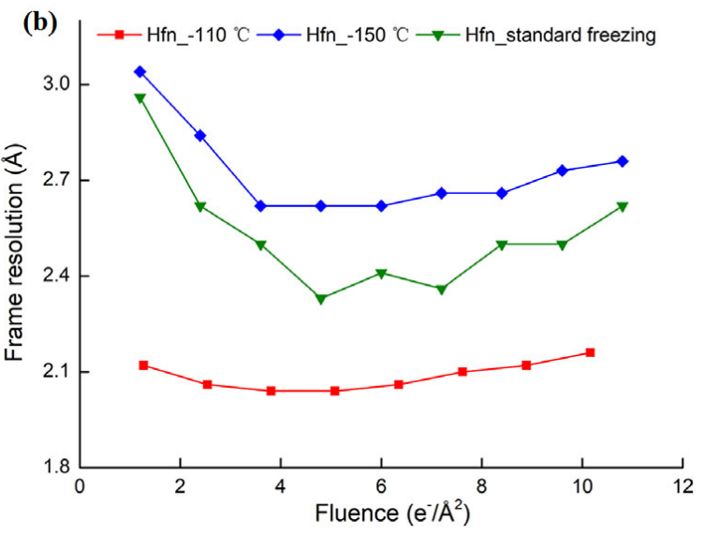
Dynamic nature
1980s，Dubochet把含水样品快速投入到-183℃的液态乙烷中，制备包埋在玻璃态冰中的低温样品来减少生物样品受高能电子束照射产生的损伤。一般认为，降温速率越快越容易产生玻璃态冰。但是玻璃态冰中的蛋白质在电子束照射初期会产生快速漂移，无法矫正，使冷冻电镜前几帧成像模糊而无法有效的应用于三维重构。电子束曝光初期的冷冻电镜数据具有最小的辐照损伤，含有最主要的高分辨信号，所以电子束诱导的快速漂移是实现原子分辨率结构解析以及易辐照损伤氨基酸高分辨重构所需要克服的壁垒，被Richard Henderson在2017年的诺贝尔奖报告中称为冷冻电镜中的"Key outstanding problem"
经过近5年的攻关，我们发现快速漂移源自玻璃态冰在急速冻结时产生的应力，该应力和过高的降温速率相关，可以通过降低冷却速率来减少。通过优化冷冻制样技术，降低冷冻过程中样品的降温速率，我们最终实现了蛋白质快速漂移的消除。在降低冷却速率制备得到的冷冻样品中，我们的数据分析展示冷冻电镜前几帧数据被有效恢复，从恢复的电子密度图中我们可以清晰看到在普通冷冻样品结构中无法得到的辐照损伤敏感的氨基酸侧链信息。

Slide 16
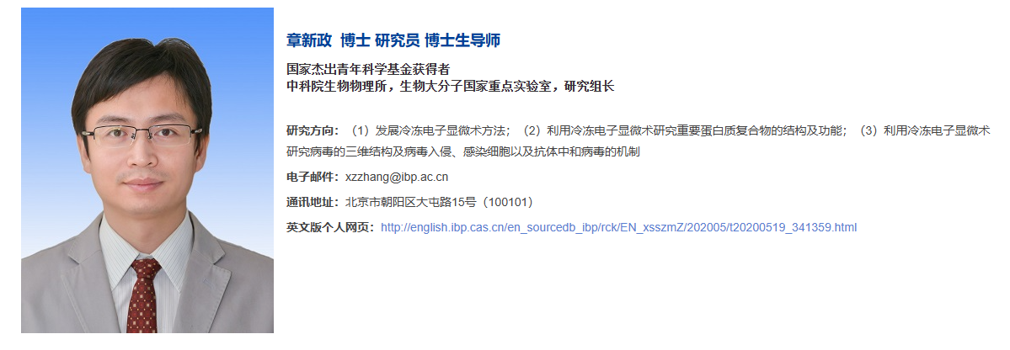
Something interesting

Slide 17
Limitation
Dynamic nature
Low contrast
Sample homogeneity

Slide 18
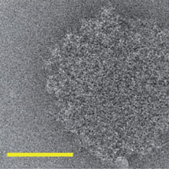
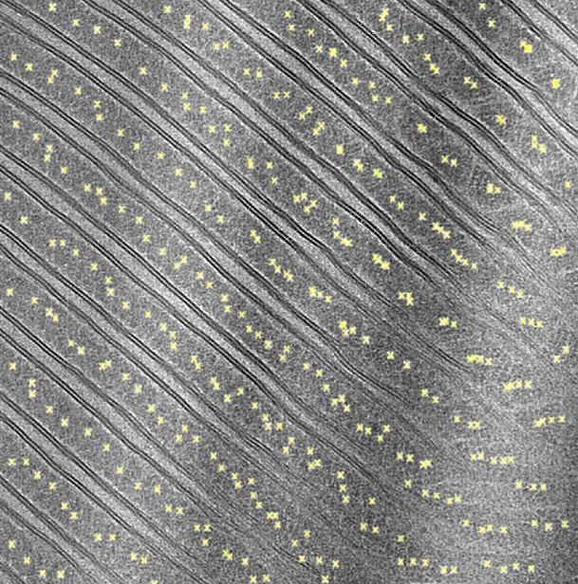
Low contrast
2012
2020
2023

Slide 19
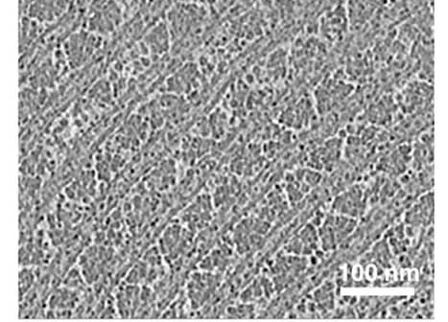
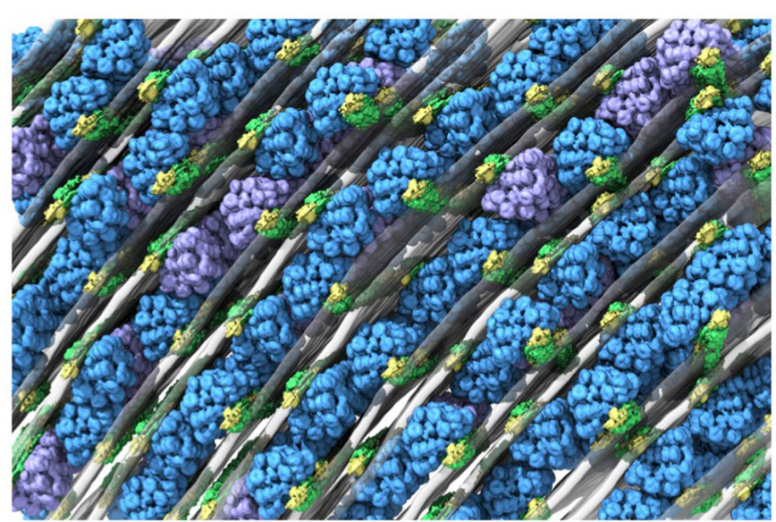
Something interesting

Slide 20
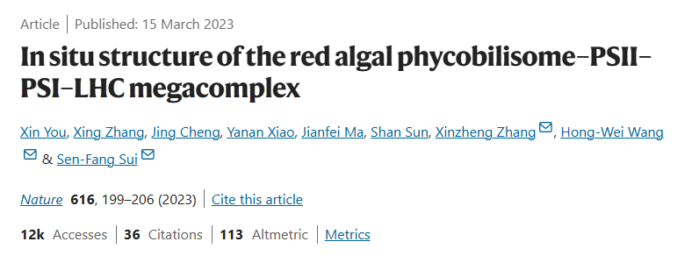
Something interesting
GisSPA

Slide 21
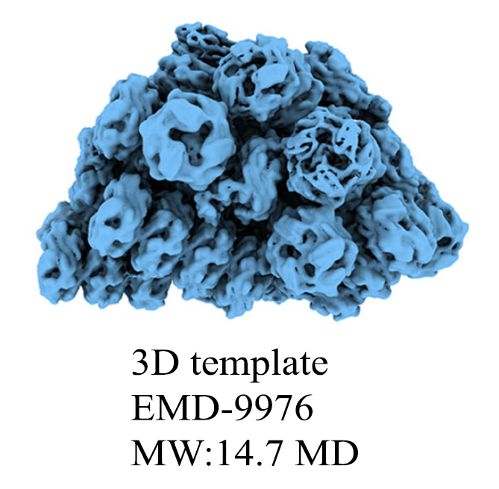
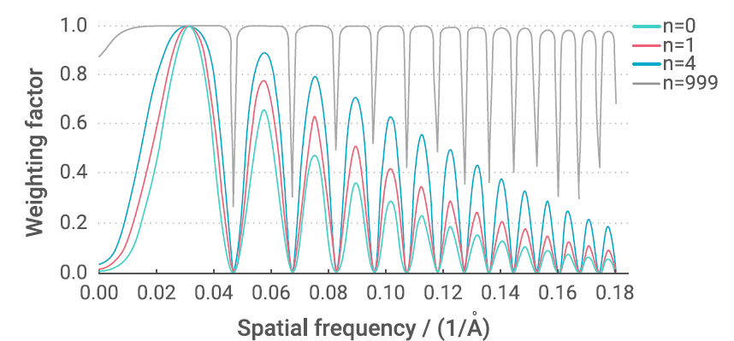
Something interesting

Slide 22
Limitation
Dynamic nature
Low contrast
Sample homogeneity

Slide 23

Thank you for your listening!

